Slide 1
Analysis of digital aspects within proposals approved for COVID-19 vaccine deployment
An analysis of proposals to UNICEF, Gavi, the Global Fund to fight AIDS, Tuberculosis and Malaria and the World Bank.

Slide 2
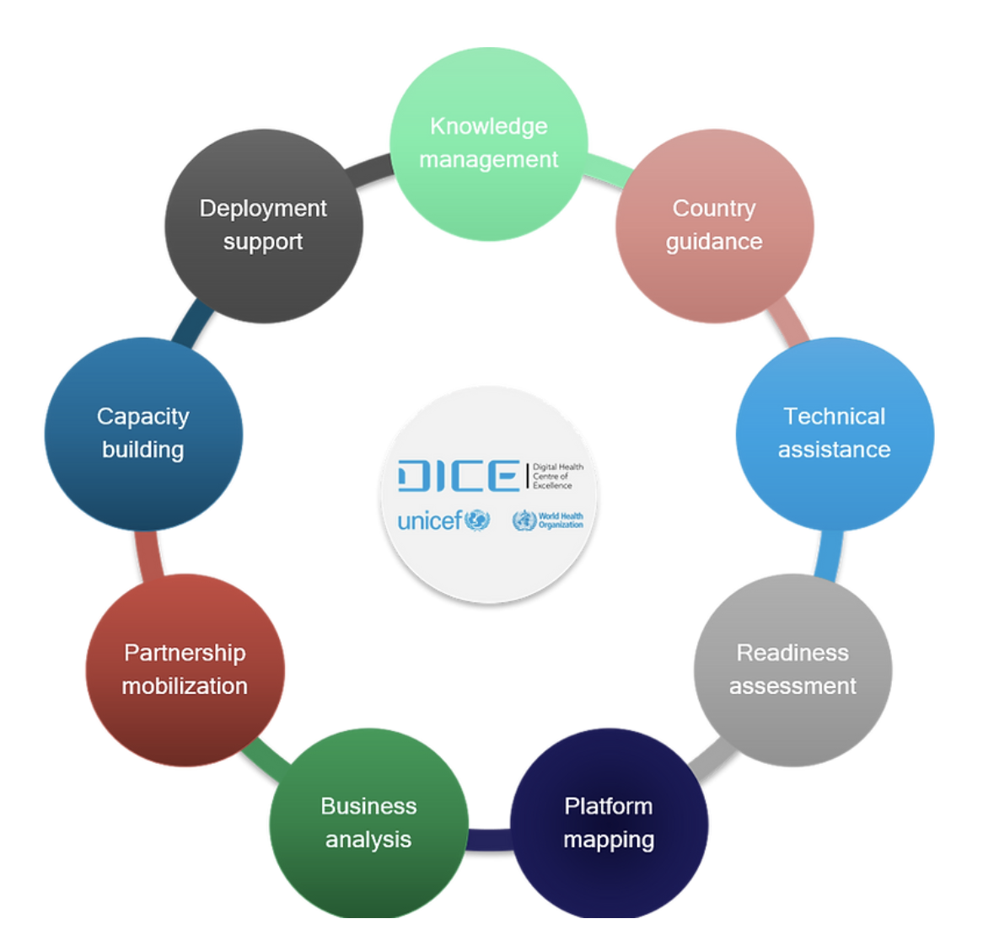
Overview
Background
Purpose
Methodology
Overall results
Examples
Methdological considerations

Slide 3
Background
Gavi and UNICEF funds are provided under the COVID-19 Vaccine Delivery Support (CDS) funding envelop and is designed to enable rapid roll-out and scale up of COVAX-funded vaccine doses.
In April 2021 UNICEF and WHO launched the Digital Health Center of Excellence (DICE) to facilitate sustainable and scalable deployment of carefully chosen digital health solutions to support the COVID-19 vaccine roll-out, and support health systems needs in the context of the COVID-19 pandemic.
DICE responds to countries’ support requests and provides coordinated technical assistance to the design and planning of sustainable and scalable deployment of carefully chosen digital health solutions; from planning distribution of commodities and vaccines, tracking supplies, surveillance and case detection, monitoring coverage of services, and communicating to generate demand and reduce misinformation.
The purpose of this review is to understand if and how digital aspects have been included in the COVID-19 funding requests for vaccine deployment
Specifically, what types of digital aspects are countries planning to develop/implement?

Slide 4
Methodology
Included documents: All publicly available (until 1st of May 2022) early access and needs based CDS applications for Gavi and UNICEF, Global Fund C19RM and World Bank COVID-19 Response AF (additional financing) applications were included in the review.
Data abstraction: Each document were searched by list of keywords representing various potential digital aspects, whereafter the data were abstracted based on the NDVP pillars. Where funding information were available this was added.

Slide 5
Results – Description of applications
UNICEF EAW
UNICEF NBW
Gavi EAW & NBW
Global Fund
World Bank
27
28
57
31
98
70
In total, 311 applications were reviewed from 120 countries (most from Sub-Saharan Africa)
Of these, 39 did not include a digital aspect and 272 (88%) included at least one digital aspect.
707 digital aspects identfied, 618 with funding linked to it, 89 without (primarily World Bank).
311

Slide 6
Results – Funding and digital aspects
UNICEF EAW & NBW
Gavi EAW & NBW
Global Fund
World Bank
27
28
57
31
98
70
Total amount funded: 38 Million USD
Total amount funded: 647 Million USD
Total amount funded: 2 301 Million USD
Total amount funded: 5 916 Million USD
Maximum towards activities that include digital aspects: 9 Million USD (23%)
Median (IQR) % of investment per digital aspect out of the total application funding:
11% (5-22%)
Maximum towards activities that include digital aspects: 122 Million USD (19%)
Median (IQR) % of investment per digital aspect out of the total application funding:
6% (1-15%)
Maximum towards activities that include digital aspects: 286 Million USD (12%)
Median (IQR) % of investment per digital aspect out of the total application funding:
2% (1-4%)
Maximum towards activities that include digital aspects: 851 Million USD (14%)
Median (IQR) % of investment per digital aspect out of the total application funding:
7% (2-16%)
→ All applications had a signficiant amount of funding directed towards acitivities that include digital aspects.

Slide 7
Results – Description of digital aspects
→ Majority of digital aspects concerned immunization monitoring systems.
Vaccine acceptance and uptake, vaccine safety, Covid-19 surveillance and supply chain together with overall planning were also prevalent.

Slide 8
Results – Description of digital aspects per region
→ Similar distribution of digital aspects in each NDVP category across regions.

Slide 9
Results – Description of digital aspects per donor
→UNICEF applications were focused on NDVP 2, 7, 8, 9 and 10 while Gavi applications were more focused on NDVP category 8, 9 and 10. Global Fund and World Bank applications included many digital aspects in NDVP category 6, 8, 10 and 11. This is not surprising given the different focus of the donors.

Slide 10
Results – Examples
Country | Application | Examples
Angola | Gavi | a) Local microplanning; b) Distribution of vaccine and material by levels (purchase of fuel, rental of vehicles); c) Digital preregistration and registration of the vaccination, (purchase of computers, optical lectors. printers, paper, internet payment( digital vaccination registry (ReDIV); d) Temporal hiring of data clecks for pre-registration and digital recording of vaccines for some districts d) Complementary printing of vaccination cards.
 | Global Fund C19RM | In this context, as mitigation actions, the reinforcement of training actions are proposed and an analysis of barriers to the use of the electronic platform developed to report covid-19 health information from various points in the country using DHIS-2 platform that will facilitate the preparation of monthly reports in order to contribute timely to decision-making and policy-making and new country pandemic control strategies.
 | World Bank AF2 | Data collection systems, including 1) social media listening and rumour management, and 2) assessing behavioural and social data, are being piloted.
Mongolia | UNICEF | Micro-planning for vaccinating specific groups of population is timely; and, even so is GIS-informed microplanning for vaccinating those on move, herding families in remote, rural areas, and the immigrant families in suburban, unauthorized settlement areas. This is in direct support of recommended activities after a recent NDVP review. Accordingly, MoH, NCCD and UNICEF Country Office are in firm discussions with DICE Secretariat. The technical assistance involves geo-optimization of immunization service locations, real-time planning, implementation and monitoring of COVID-19 vaccination and other co-delivered services.
 | Global Fund C19RM | The one of innovative approaches adopted and introduced at the country level is the Multi-source surveillance data platform. The multi-sectoral organizations now can receive updates and latest data in a timely manner by having the integrated dashboard in place and by developing the surveillance system of multiple sources. About 700 HCFs using this platform as of 2020 for their surveillance, and integrating healthcare services they provide daily basis, which are delivered to the pertinent managers and decision makers via the integrated dashboard. Aim is to integrate this into various aspects of TB and HIV programs.
 | World Bank AF2 | A massive communication campaign tailored to the context of Mongolia will be implemented through multiple communication channels, which will be developed based on evidence from qualitative and quantitative baseline surveys using innovative technologies on public knowledge, perceptions and attitude towards the new vaccine, vaccine hesitancy and barriers analysis, analysis of communication capacity of service providers and stakeholder analysis and mapping etc.

Slide 11
Results – Examples cont.
Country | Application | Examples
Nepal | Gavi | Professional Services (EPS) Logistics contractors will assist district to develop Micro planning, training, monitoring and supervision and conducting the activities. Improve the cold chain capacity, vaccine delivery, monitoring and reporting.
 | Global Fund C19RM | Strengthening systematic and targeted scale-up of eLMIS/mSupply linking with health facilities, central and provincial stores to timely collect and distribute logistic data to attain a well-defined supply chain strategy for COVID-19 responses and HIV, TB and malaria services.
 | World Bank AF2 | Support for a framework of digital technology‐ based information systems (routine data, surveillance and monitoring) and periodic studies providing evidence and data to inform COVID‐19 vaccine purchase, delivery and distribution.
El Salvador | UNICEF | No explicit digital aspects.
 | Global Fund C19RM | The health system as been re-oriented and focused on Integrate the health systems for the full implementation of the Single Health Information System (SHIS) and as a result for the optimal functioning of the Integrated Health Networks. Integration of COVID-19 surveillance and regular reporting, including for contact tracing, into existing HMIS platforms. A digital transformation is required to achieve the capacity, flexibility and agility needed to simultaneously integrate data obtained from different levels of health care into clinical practice, from the area of interventions to the different levels of care for evidence-based decision-making. There is a lack of interoperability, basic technological equipment, nominal registry for all infectious diseases.
 | World Bank AF2 | Registration system will display information on the person to be vaccinated, dates, vaccination sites on information on the vaccine to be administered. Web-operated National Registry is launched with three modules: web query, vaccination record, and vaccination distribution record. These information systems include different components: (i) a registration system that allows for tracking and tracing of vaccines from arrival at a vaccination center until application in a person and disposal (these processes have been pilot-tested to ensure functionality); (ii) the monitoring of supply chain processes and cold chain tracking; (iii) a nominal record based on the national registry that allows for second dose follow-up; (iv) the issuance of vaccination certificates to every person; and (v) the implementation of surveillance reporting instruments at the regional level for daily monitoring. Oversight, verification, and surveillance related to vaccine deployment will be further strengthened, drawing on digital tools and technology to the extent possible.

Slide 12
Methdological considerations
Limitations of review: For Global Fund and World Bank applications detailed descriptions of digital or potentially digital aspects of proposed activities were often lacking even though they might be implied by the planned activities. Further, funding numbers were often not clearly linked to a specific digital aspect, hence these numbers should be considered with caution. Also, it is not always clear what has been implemented already, what is planned and how (if it is not already functioning) digital aspects will be implemented.
The full data sheet and futher details on methodology is available here.
Proposals were obtained from:
UNICEF and Gavi CDS: https://partnersplatform.who.int/
World Bank: World Bank Support for Country Access to COVID-19 Vaccines
The Global Fund to Fight Aids, TB and Malaria: The Data Explorer - Datasets (theglobalfund.org)

Slide 13
Discussion/Implications
Countries have asked for funding that include digital aspects, how are these investments defined, utilised and tracked across countries/donors?
Is it possible to coordinate investments for digital aspects across donor agencies?
How are these investments supporting the health system, and health information system, more broadly beyond COVID-19?

